Slide 1

Digital Integrated Circuits
A Design Perspective
Jan M. Rabaey
Anantha Chandrakasan
Borivoje Nikolic
Introduction
July 30, 2002

Slide 2
What is this book all about?
Introduction to digital integrated circuits.
  CMOS devices and manufacturing technology. CMOS inverters and gates. Propagation delay, noise margins, and power dissipation. Sequential circuits. Arithmetic, interconnect, and memories. Programmable logic arrays. Design methodologies.
What will you learn?
  Understanding, designing, and optimizing digital circuits with respect to different quality metrics: cost, speed, power dissipation, and reliability

Slide 3
Digital Integrated Circuits
Introduction: Issues in digital design
The CMOS inverter
Combinational logic structures
Sequential logic gates
Design methodologies
Interconnect: R, L and C
Timing
Arithmetic building blocks
Memories and array structures

Slide 4
Introduction
Why is designing digital ICs different today than it was before?
Will it change in future?

Slide 5
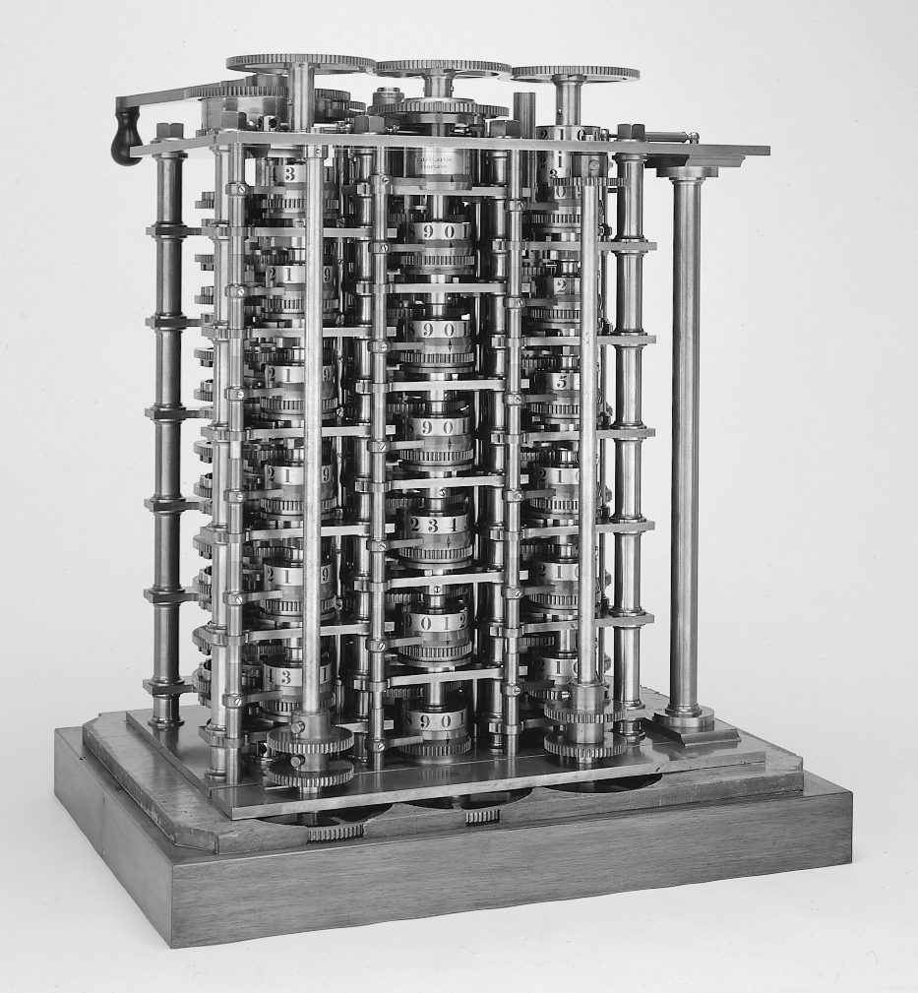
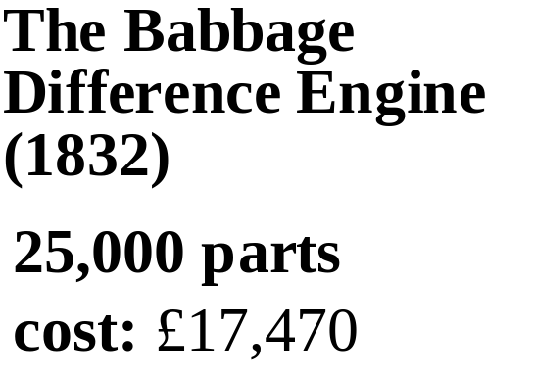
The First Computer

Slide 6
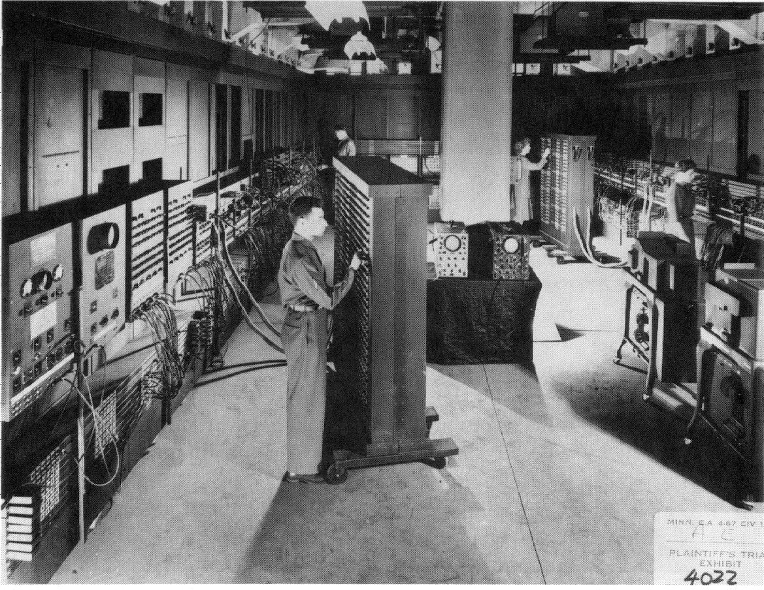
ENIAC - The first electronic computer (1946)

Slide 7
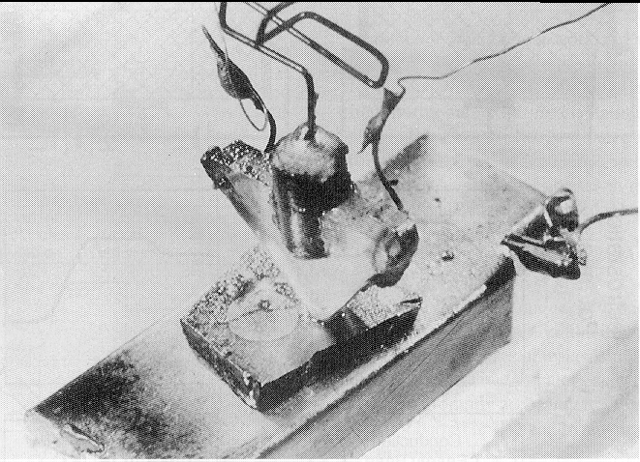
The Transistor Revolution
First transistor
Bell Labs, 1948

Slide 8
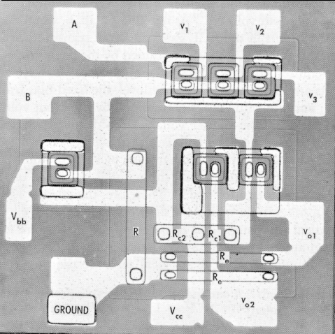
The First Integrated Circuits
Bipolar logic
1960’s
ECL 3-input Gate
Motorola 1966

Slide 9
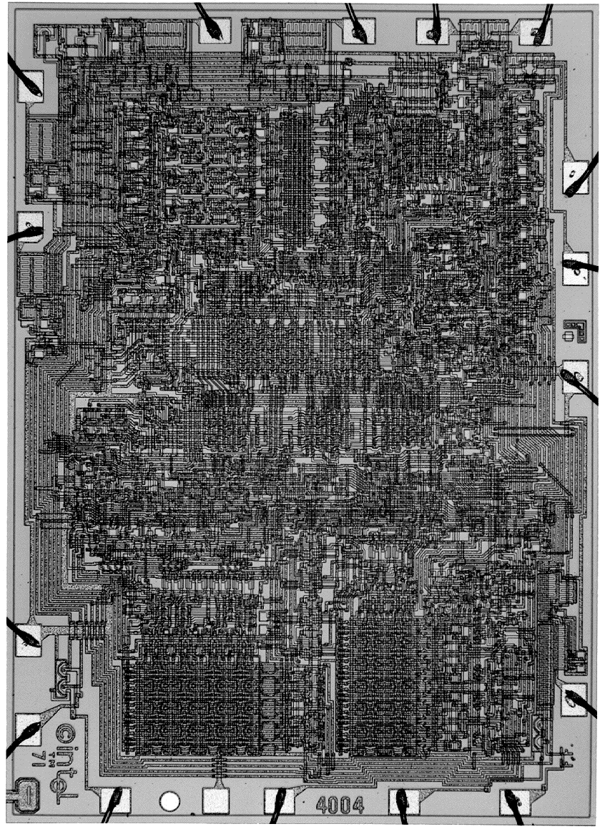
Intel 4004 Micro-Processor
1971
1000 transistors
1 MHz operation

Slide 10
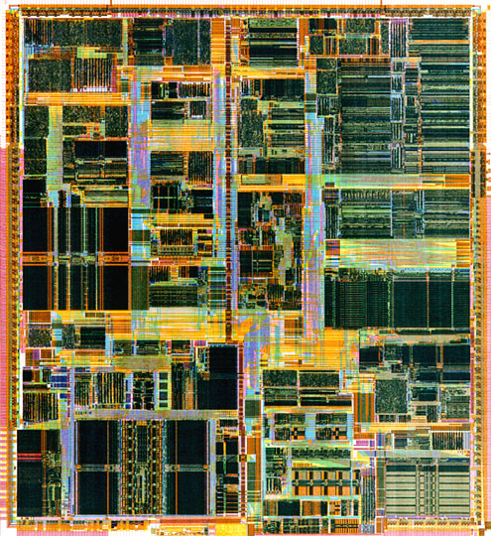
Intel Pentium (IV) microprocessor

Slide 11
Moore’s Law
In 1965, Gordon Moore noted that the number of transistors on a chip doubled every 18 to 24 months.
He made a prediction that semiconductor technology will double its effectiveness every 18 months

Slide 12
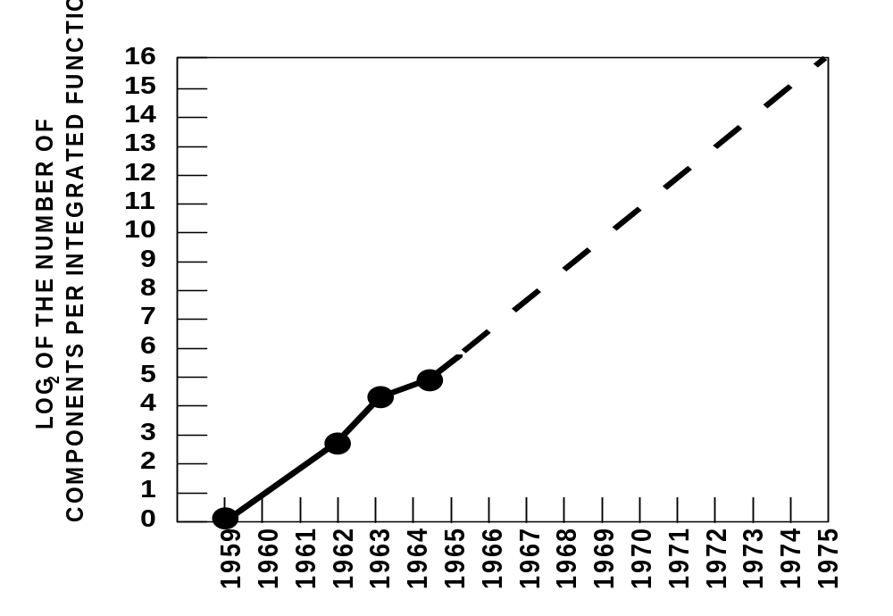
Moore’s Law
Electronics, April 19, 1965.

Slide 13
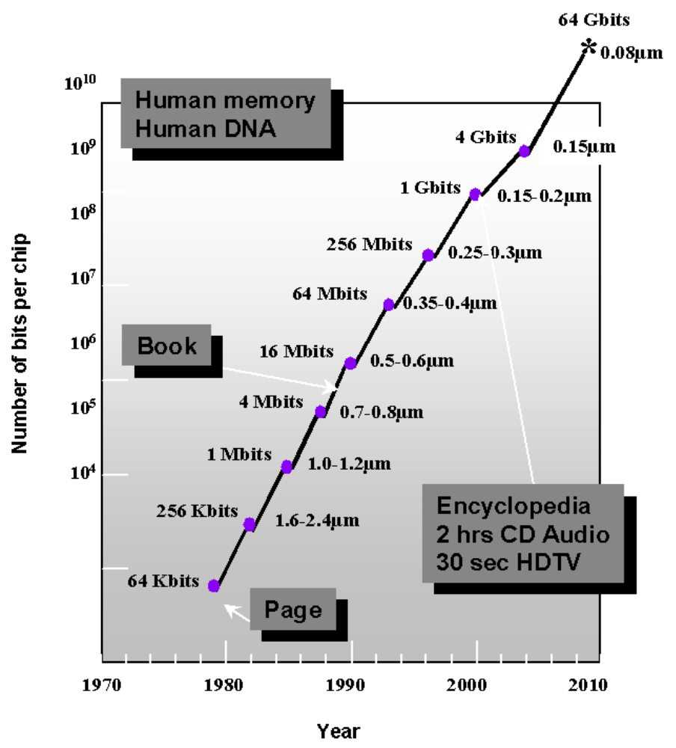
Evolution in Complexity

Slide 14
Transistor Counts
1 Billion Transistors
K
1,000,000
100,000
Pentium® III
10,000
Pentium® II
Pentium® Pro
1,000
Pentium®
i486
100
i386
80286
10
8086
Source: Intel
1
1975
1980
1985
1990
1995
2000
2005
2010
Projected
Courtesy, Intel

Slide 15
Moore’s law in Microprocessors
1000
100
2X growth in 1.96 years!
10
P6
Transistors (MT)
Pentium® proc
1
486
386
0.1
286
Transistors on Lead Microprocessors double every 2 years
8085
8086
0.01
8080
8008
0.001
4004
1970
1980
1990
2000
2010
Year
Courtesy, Intel

Slide 16
Die Size Growth
100
P6
Die size (mm)
486
Pentium ® proc
10
386
8080
286
8086
~7% growth per year
8085
8008
~2X growth in 10 years
4004
1
1970
1980
1990
2000
2010
Year
Die size grows by 14% to satisfy Moore’s Law
Courtesy, Intel

Slide 17
Frequency
10000
Doubles every
2 years
1000
100
P6
Frequency (Mhz)
Pentium ® proc
486
10
8085
286
386
8086
1
8080
8008
0.1
4004
1970
1980
1990
2000
2010
Year
Lead Microprocessors frequency doubles every 2 years
Courtesy, Intel

Slide 18
Power Dissipation
100
P6
Pentium ® proc
10
286
486
Power (Watts)
8086
386
8085
1
8080
8008
4004
0.1
1971
1974
1978
1985
1992
2000
Year
Lead Microprocessors power continues to increase
Courtesy, Intel

Slide 19
Power will be a major problem
100000
18KW
10000
5KW
1.5KW
1000
500W
Pentium® proc
Power (Watts)
100
286
486
10
8086
386
8085
8080
1
8008
4004
0.1
1971
1974
1978
1985
1992
2000
2004
2008
Year
Power delivery and dissipation will be prohibitive
Courtesy, Intel

Slide 20
Power density
10000
Rocket
Nozzle
1000
Nuclear
Power Density (W/cm2)
Reactor
100
8086
10
4004
Hot Plate
P6
8008
8085
386
Pentium® proc
8080
286
486
1
1970
1980
1990
2000
2010
Year
Power density too high to keep junctions at low temp
Courtesy, Intel

Slide 21


Not Only Microprocessors
Cell
Phone
Small
Signal RF
Power
RF
Digital Cellular Market
(Phones Shipped)
Power
Management
1996 1997 1998 1999 2000
Units 48M 86M 162M 260M 435M
Analog
Baseband
Digital Baseband
(DSP + MCU)
(data from Texas Instruments)

Slide 22
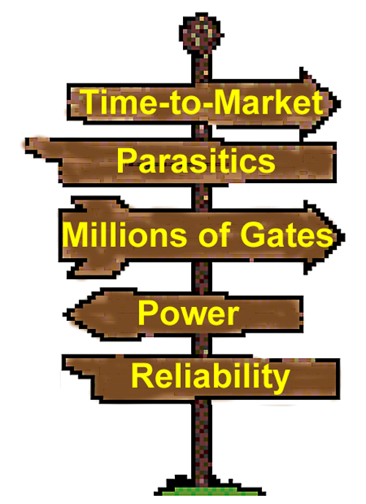
Challenges in Digital Design
∝ DSM
∝ 1/DSM
“Microscopic Problems”
• Ultra-high speed design
Interconnect
• Noise, Crosstalk
• Reliability, Manufacturability
• Power Dissipation
• Clock distribution.
Everything Looks a Little Different
“Macroscopic Issues”
• Time-to-Market
• Millions of Gates
• High-Level Abstractions
• Reuse & IP: Portability
• Predictability
• etc.
…and There’s a Lot of Them!
?

Slide 23
Productivity Trends
(M)
10,000
100,000
10,000,000
100,000,000
1,000
Logic Tr./Chip
10,000
1,000,000
10,000,000
Tr./Staff Month.
100
1,000
100,000
1,000,000
Complexity
10
58%/Yr. compounded
100
10,000
100,000
Logic Transistor per Chip
Complexity growth rate
Productivity
(K) Trans./Staff - Mo.
1
10
1,000
10,000
0.1
x
x
1
100
x
21%/Yr. compound
1,000
x
x
x
x
x
Productivity growth rate
0.01
0.1
10
100
0.001
0.01
1
10
1981
1983
1985
1987
1989
1991
1993
1995
1997
1999
2001
2003
2005
2007
2009
Source: Sematech
Complexity outpaces design productivity
Courtesy, ITRS Roadmap

Slide 24
Why Scaling?
Technology shrinks by 0.7/generation
With every generation can integrate 2x more functions per chip; chip cost does not increase significantly
Cost of a function decreases by 2x
But …
  How to design chips with more and more functions?
  Design engineering population does not double every two years…
Hence, a need for more efficient design methods
  Exploit different levels of abstraction

Slide 25
Design Abstraction Levels
SYSTEM
MODULE
+
GATE
CIRCUIT
DEVICE
G
S
D
n+
n+

Slide 26
Design Metrics
How to evaluate performance of a digital circuit (gate, block, …)?
  Cost
  Reliability
  Scalability
  Speed (delay, operating frequency)
  Power dissipation
  Energy to perform a function

Slide 27
Cost of Integrated Circuits
NRE (non-recurrent engineering) costs
  design time and effort, mask generation
  one-time cost factor
Recurrent costs
  silicon processing, packaging, test
  proportional to volume
  proportional to chip area

Slide 28
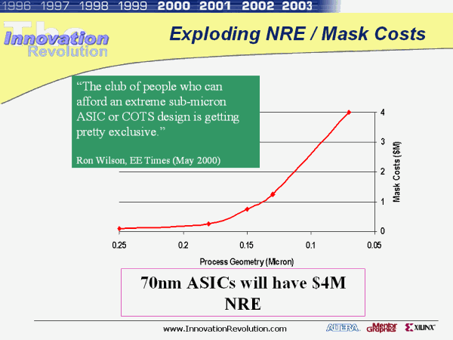
NRE Cost is Increasing

Slide 29
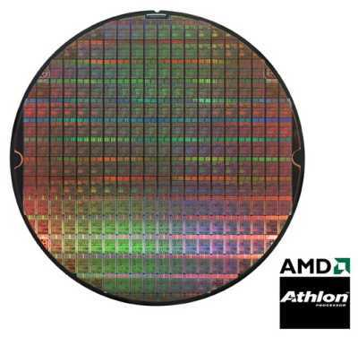
Die Cost
Single die
Wafer
Going up to 12” (30cm)
From http://www.amd.com

Slide 30
Cost per Transistor
cost:
¢-per-transistor
1
Fabrication capital cost per transistor (Moore’s law)
0.1
0.01
0.001
0.0001
0.00001
0.000001
0.0000001
1982
1985
1988
1991
1994
1997
2000
2003
2006
2009
2012

Slide 31
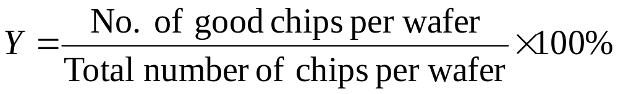
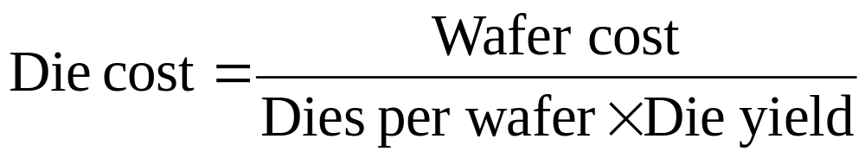
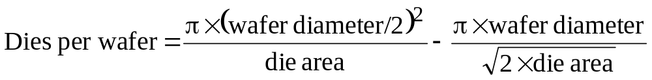
Yield

Slide 32
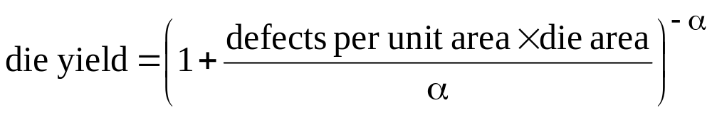
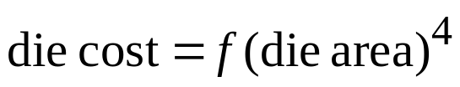
Defects
α is approximately 3

Slide 33
Some Examples (1994)
Chip | Metal layers | Line width | Wafer cost | Def./ cm² | Area mm² | Dies/wafer | Yield | Die cost
386DX | 2 | 0.90 | $900 | 1.0 | 43 | 360 | 71% | $4
486 DX2 | 3 | 0.80 | $1200 | 1.0 | 81 | 181 | 54% | $12
Power PC 601 | 4 | 0.80 | $1700 | 1.3 | 121 | 115 | 28% | $53
HP PA 7100 | 3 | 0.80 | $1300 | 1.0 | 196 | 66 | 27% | $73
DEC Alpha | 3 | 0.70 | $1500 | 1.2 | 234 | 53 | 19% | $149
Super Sparc | 3 | 0.70 | $1700 | 1.6 | 256 | 48 | 13% | $272
Pentium | 3 | 0.80 | $1500 | 1.5 | 296 | 40 | 9% | $417

Slide 34
Reliability―
Noise in Digital Integrated Circuits
v
(
t
)
V
DD
i
(
t
)
Inductive coupling
Capacitive coupling
Power and ground
noise

Slide 35
DC Operation
Voltage Transfer Characteristic
V(y)
VOH = f(VOL)
VOL = f(VOH)
VM = f(VM)
V
OH
f
V(y)=V(x)
V
Switching Threshold
M
V
OL
V
OL
V
OH
V(x)
Nominal Voltage Levels

Slide 36
Mapping between analog and digital signals
V
out
“
1
”
V
OH
Slope = -1
V
V
OH
IH
Undefined
Region
V
Slope = -1
IL
V
“
0
”
V
OL
OL
V
V
V
IL
IH
in

Slide 37
Definition of Noise Margins
"1"
V
OH
NM
Noise margin high
H
V
IH
Undefined
Region
NM
L
V
IL
Noise margin low
V
OL
"0"
Gate Output
Gate Input

Slide 38
Noise Budget
Allocates gross noise margin to expected sources of noise
Sources: supply noise, cross talk, interference, offset
Differentiate between fixed and proportional noise sources

Slide 39
Key Reliability Properties
Absolute noise margin values are deceptive
  a floating node is more easily disturbed than a node driven by a low impedance (in terms of voltage)
Noise immunity is the more important metric – the capability to suppress noise sources
Key metrics: Noise transfer functions, Output impedance of the driver and input impedance of the receiver;

Slide 40
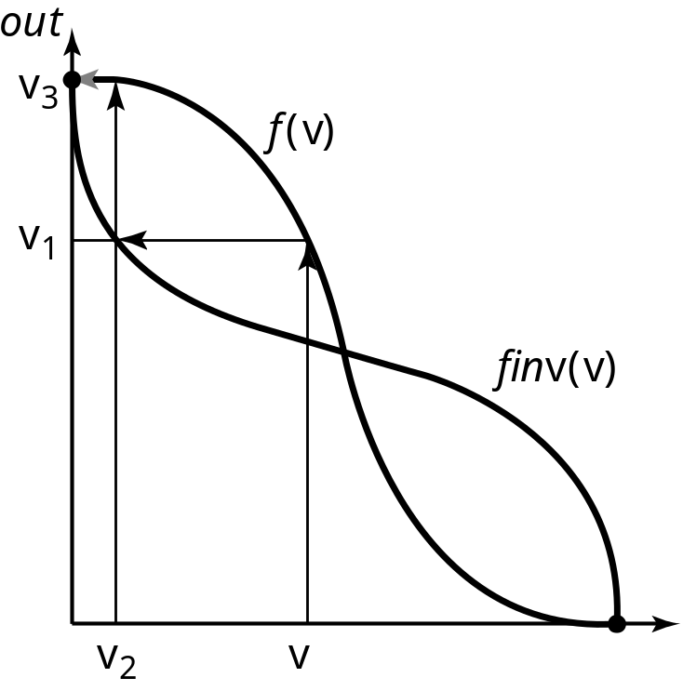
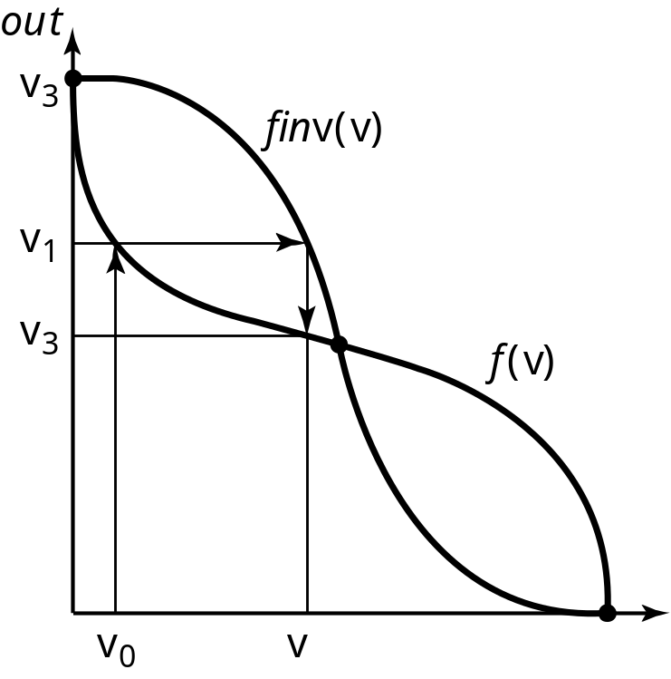
Regenerative Property
Regenerative
Non-Regenerative

Slide 41
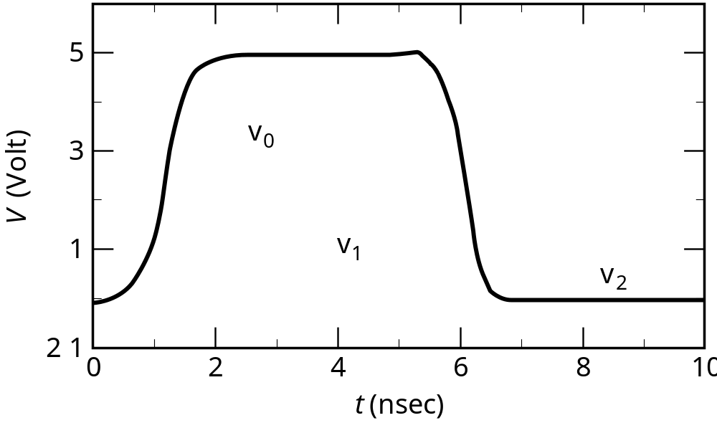
Regenerative Property
v
0
v
1
v
2
v
3
v
4
v
5
v
6
A chain of inverters
Simulated response

Slide 42
Fan-in and Fan-out
M
N
Fan-out N
Fan-in M

Slide 43
The Ideal Gate
V
out
R
=
∞
i
R
= 0
o
Fanout = ∞
NM_{H} = NM_{L} = V_{DD}/2
g = ∞
V
in

Slide 44
An Old-time Inverter
5.0
4.0
NM
L
3.0
(V)
2.0
out
V
V
M
NM
H
1.0
0.0
1.0
2.0
3.0
4.0
5.0
V
in
(V)

Slide 45
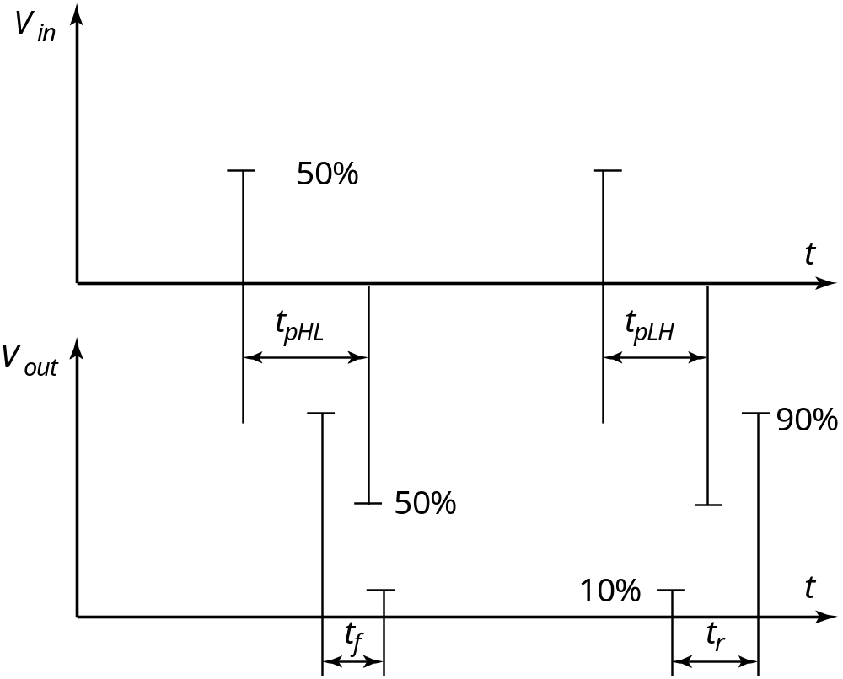
Delay Definitions

Slide 46
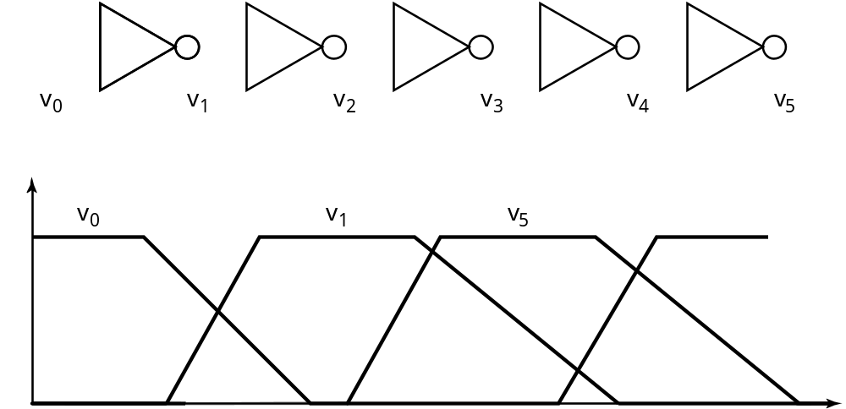
Ring Oscillator
T = 2
×
t
×
N
p

Slide 47
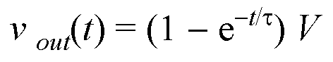
A First-Order RC Network
R
v
out
v
in
C
t_{p} = ln (2) τ = 0.69 RC
Important model – matches delay of inverter

Slide 48
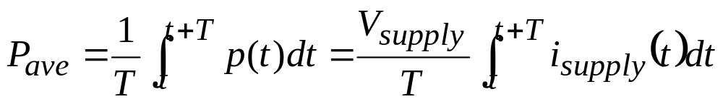
Power Dissipation
Instantaneous power:
p(t) = v(t)i(t) = V_{supply}i(t)
Peak power:
P_{peak} = V_{supply}i_{peak}
Average power:

Slide 49
Energy and Energy-Delay
Power-Delay Product (PDP) =
E = Energy per operation = P_{av} × t_{p}
Energy-Delay Product (EDP) =
quality metric of gate = E × t_{p}

Slide 50
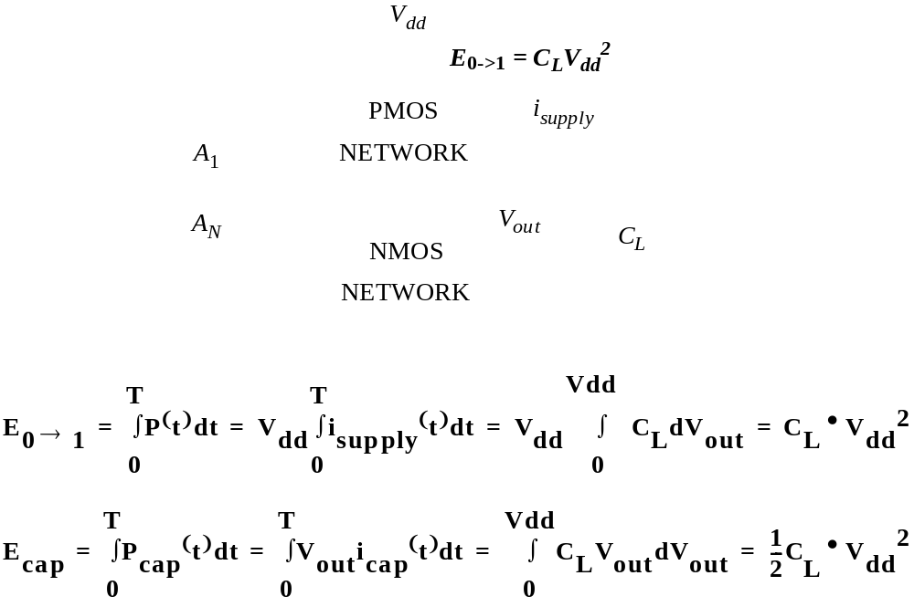
A First-Order RC Network
R
v
out
v
in
C_{L}

Slide 51
Summary
Digital integrated circuits have come a long way and still have quite some potential left for the coming decades
Some interesting challenges ahead
  Getting a clear perspective on the challenges and potential solutions is the purpose of this book
Understanding the design metrics that govern digital design is crucial
  Cost, reliability, speed, power and energy dissipation

